Slide 1
Dealing with Cyber Safety and Security in the Classroom
Techniques to bring Cyber Safety and Security Lessons to Life.
Graeme Stevens

Slide 2
Today’s Workshop
Research
Identifying Cyber Security Threats that our young people face.
Looking at Research into the developing nature of these threats.
Approaches taken to teach cyber safety
Hands on Lab Work
Crime Scripting
How safe and secure is private chat?
How viruses work
How to circumvent an Anti Virus
Hacker High School program

Slide 3
Lesson v Activity: Terminology
Activity = A task we are doing to further understanding
Lesson = Something I currently do with my students.

Slide 4
Educational Philosophy

Slide 5
In Criminal Investigation the mantra is..
To catch a thief you need to act/think like a thief
Learn the tricks of the trade the criminals learn.
Learn the skills the criminals learn.
Expose yourself to those threats (within a training environment).
BECOME THE CRIMINAL (ethically)
How do we equate that with Cyber Security and Safety Teaching?

Slide 6
We do the same..
Students need to learn about threats (What)
Students need to understand threats
(How When Why)
Students need to be able to identify threats that may be coming (Where When and actions to take)
Have to have some kind of “interaction” or “experimentation” within these areas in the classroom.

Slide 7
Lesson Pre-Requisites (to do this in School)
A good relationship with your Network Manager!
An open minded Management!.
The appropriate software (though most have free versions).
Anti Virus and Firewall switched off for the duration of the experiments.
Or……

Slide 8
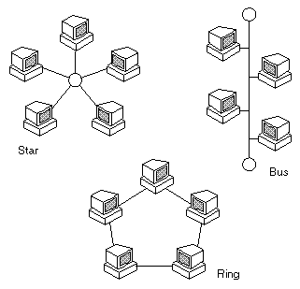
Build your own network!
Donated PC’s (4)
Some running Windows
Some running Linux Backtrack
Laptop running a Virtual MS Server or a donated server.
Switch
Cables
Create a domain hacknet (or whatever)

Slide 9
Cyber Safety and Security Threats

Slide 10

When seeing these threats remember..

Slide 11
What are the main Cyber Safety (and Security)Threats?
According to CyberFamily (2011):
1. Inappropriate Material 2. Cyberbullying 3. Online Predators 4. Sharing Personal Information 5. Email, IM & Chatrooms 6. Sharing Pictures & Videos 7. Cell Phones & Wi-Fi Gadgets 8. Social Network Sites 9. Online Gaming 10. Viruses, Malware & Adware

Slide 12
Meanwhile, our students are searching for... (Top 15 Searches by children in 2009, Norton)
YouTube, Google, and Facebook
Boys’ top 25 search terms: social networking sites, inappropriate terms, and games.
Girls’ top 25 search terms were main comprised of social networking sites, as well as music and entertainment/celebrity terms.
Boys search more adult topics compared to girls (13% vs. 2%).

Slide 13
Threats explained in more detail…

Slide 14
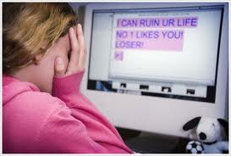
Cyberbullying
Top 10 ways people are bullied online:
1. Instant Messaging/Text Messaging Harassment
2. Stealing Passwords
3. Blogs
4. Web Sites
5. Sending Pictures through E-mail and Cell Phones
6. Internet Polling
7. Interactive Gaming
8. Sending Malicious Code
9. Sending Porn and Other Junk E-Mail and IMs
10. Impersonation
(Scoop, 2010)

Slide 15
Activity: Which of the following is the safest password?
A: golf77
B: gr@3m3_st3v3ns (P@55w0rd)
C: E5%@#**??
D: Mary had a little lamb

Slide 16
Answer
Password: golf77
Approximate Cracking Time: 15 Seconds
Password: gr@3m3_st3v3ns
Approximate Cracking Time: 35 Minutes
E5%@#**??
Approximate Cracking Time: 55 Minutes
Mary had a little lamb
Approximate cracking time: Days +

Slide 17
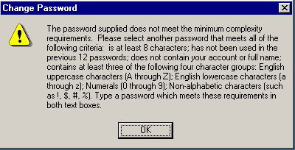
Why is a phrase better ( esp for Kids)?
EASY TO REMEMBER FOR A SMALL CHILD

Slide 18
Back to Cyberbullying….

Slide 19
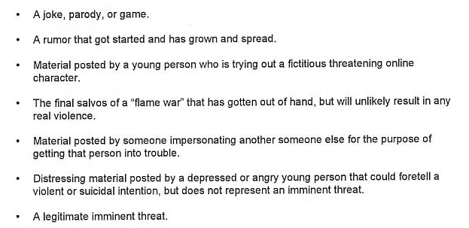
According to research, what constitutes Cyber Bullying?
Willard (2009)

Slide 20
The four types of cyberbully (and motives)
The Vengeful Angel
Fighting perceived injustice
Power Hungry
Frighten and embarrass victims to feel in control
Mean Girls
Planned attack involving groups attacking victims
Inadvertent Cyber bully
They don’t see themselves as a bully. It may just be a role play or something to occupy time

Slide 21
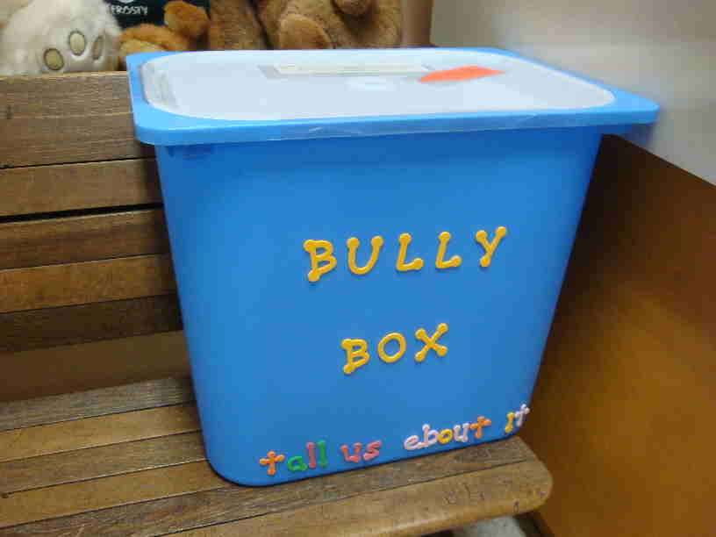

Reliance on Students communicating Problems
Creating an environment for students to tell us.
reportonlinebullying@emsdoha.net

Slide 22
Onto the next threat…

Slide 23
Sharing Personal Information
Through various medium (soc network, chat etc) some 90% of teenagers admit to sharing personal information willingly with strangers.
Many have their email address, mobile number and sometimes street address on their social networking accounts.
When researched, 35% of facebook account holders had fully public profiles.

Slide 24
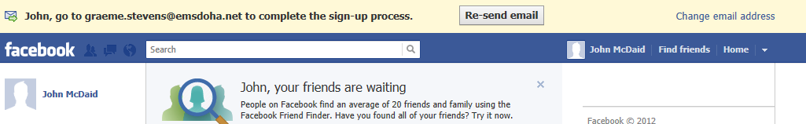
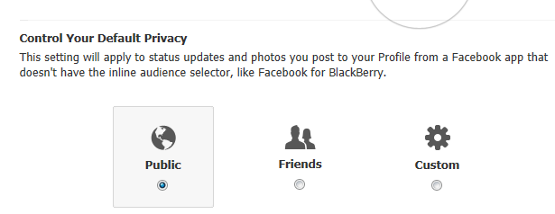
So what do websites do to keep you safe?

Slide 25
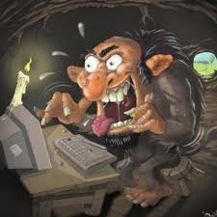


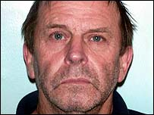
Online Predators
Ask a child what they think an Internet Predator looks like and you get something like this > > > > > >
Michael Wheeler
(Secom, 2011)
Leon Sadowski
Douglas Lindsell
http://www.badpeopleproject.org/

Slide 26
Lesson 1: Warning Signs from the Chatroom.
This lesson looks at crime scripting.
We are going to look script extracts of cases where there was attempted grooming of children.
*Scripts have been slightly altered to keep them acceptable.

Slide 27
Essential Questions, Lesson 1
What does this script tell you about the time taken by an offender to get to know their victim?
How do they gain trust of their intended victim?
At what point does the real purpose of their interest in the child become clear?
Ultimately, what lessons can children learn so they are on guard for attempts at grooming them?

Slide 28
Sample Lesson from Australia: Jeremy’s Friend
http://www.cybersmart.gov.au/cybernetrix/shared/pdf/case_jeremys_friend.pdf

Slide 29
Email and Chatrooms
This broad area covers:
Potential Misuse of Email (personal attack, phishing etc)
Use of mainstream chatrooms
Use of Messenger style instant chat
Use of IRC (Internet Relay Chat)****

Slide 30

Why has IRC become so popular?
Restrictions in mainstream chat rooms, such as Yahoo!

Slide 31
Activity: Create an Account and use IRC Chat
Configure an IRC Chat account and go underground using Mozilla Firefox’s Chatzilla.
Explore the “undernet”.
Lesson details in network folder.

Slide 32
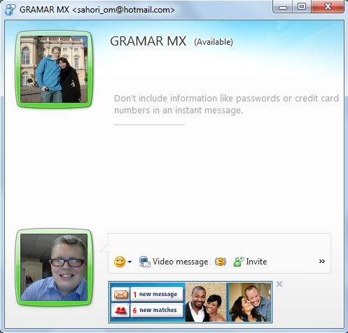
Lesson 2: How Private is Private “Chat”?
Children assume that
Two people talking
On chat that are
Friends are also safe .
They assume the
Conversation is private
BUT IS IT????

Slide 33
Essential Questions, Lesson 2
What do the results say about our private use of chat lines?
Who would have an interest in “snooping” on your conversation?
How often have you given “personal” details out to friends that could have been intercepted?

Slide 34
Break Time!
Grab yourself a coffee and some snacks and have a well deserved 10 minute rest!

Slide 35
Sharing Images and Videos
45% of young people in the US admit sharing images of themselves with strangers.
Of which, 35% openly admit sending “adult images” of themselves.
Being recorded by others and the third party posting videos is becoming a big problem.

Slide 36
Mobile Phones
Mobile Phones are essentially mini computers now and use similar services as a PC.
Mobile Phones are therefore similarly if not more vulnerable than a standard PC.
e,g UK Phone Hacking Scandal.
Is it easy?
http://www.easymobilephonespying.com/
Well, information about it is easy to find!

Slide 37
Social Networking Sites
Facebook etc are breeding grounds for grooming, bullying and even, burglary.
Rise in occurrences of robbing houses after first checking “status” of the owner on facebook.

Slide 38
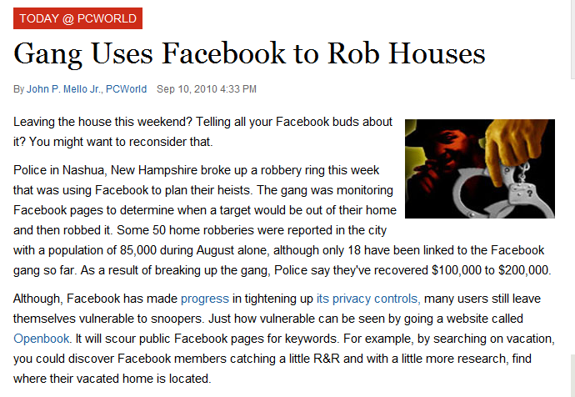
For example

Slide 39
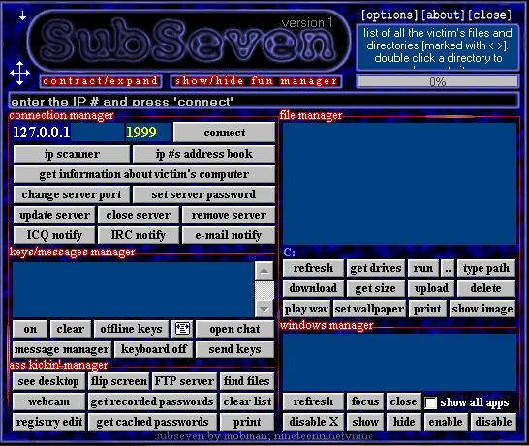
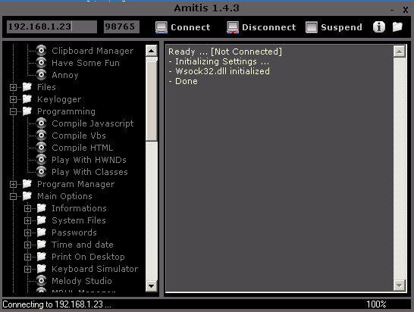
Viruses and Malware

Slide 40
Lesson 3: How do Viruses work?
This lesson looks at how a trojan works:
Trojan has two parts – Server and Console.
The trick is to get the victim to trigger the server file on their machine.
Usually this means naming it something that the victim cant help but open to see.
In this lesson, you will take turns being the attacker and the victim, by running a virus called “Let me Rule”.

Slide 41
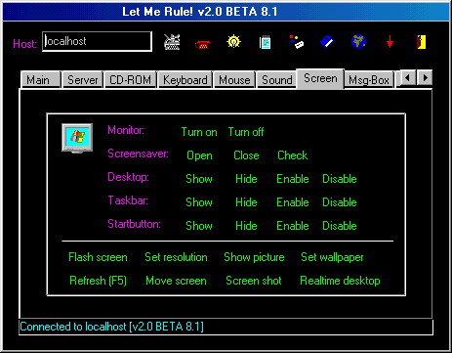
Let Me Rule Console

Slide 42
Essential Questions for Lesson 3
How does a Virus get into a computer system?
What tricks might need to be used to get round your security?
How does a virus operate?
Can a virus get into a computer without the help of the user?

Slide 43
Solutions?
Most students will suggest avoiding viruses only needs:
An Anti Virus Program
To use a non windows machine

Slide 44
And now, the obvious question that follows….

Slide 45
Lesson 4: How useful is an Anti-Virus?
Following on from Lesson 3 about using Viruses, this lesson asks how safe an anti virus is that we use in school or at home?
Using TWO typical “masking” techniques a hacker may use to hide a virus, you will test your masked viruses against 42 industry standard anti viruses.

Slide 46
Essential Questions, Lesson 4
How many industry standard anti viruses “found” your virus?
What do the results mean for trusting anti viruses in the future?
If an AV wont save us, what will?
“No Virus Found”. It makes us happy to see this message, but is it right?
You cant get viruses on a Mac or Linux, right?

Slide 47
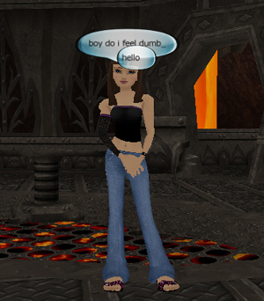
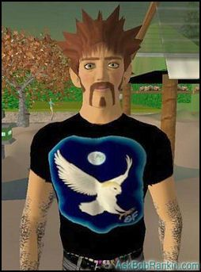
Online Gaming esp MMRPG
Mass Muti-Player Role Playing games, such as World of Warcraft and Second Life can be used to bully, groom or simply intimidate.

Slide 48

Dark Side to Second Life
We know chat can be used for bullying, signs can be made but what else can affect children?
Avatar Rape is becoming common in MMRPG.

Slide 49
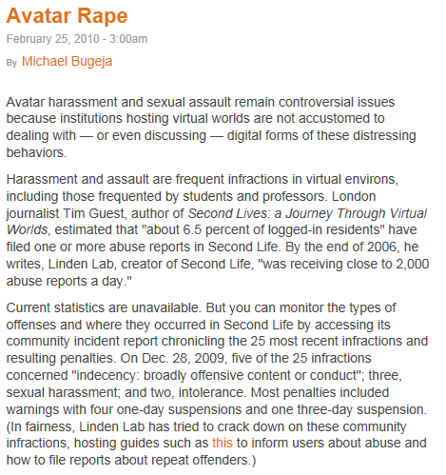
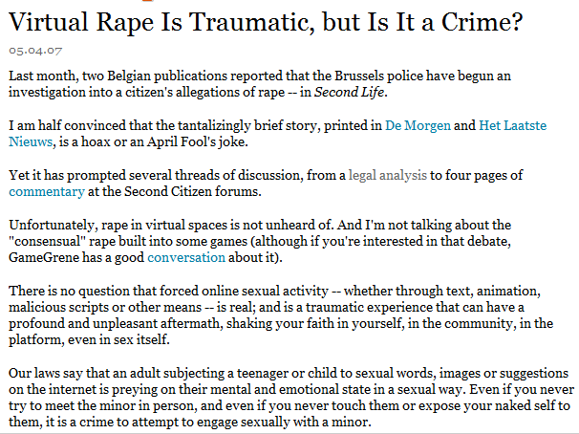
Legal fight in Belguim

Slide 50
Extra Curricular Clubs and Courses
Introduction to Hacker High School

Slide 51
Video from a past student

Slide 52
Does teaching Hacking make students “bad”
In my experience, No
Most are very angry about the fact that their own data is so easily at risk.
Many go on to do more research beyond HHS including IB EE and University.

Slide 53
Try out Hacker High School
Go to www.hackerhighschool.org
Download Lesson 2 (Windows and Linux)
Using a virtual machine on your desktop, investigate Linux as an operating system.

Slide 54
Summary
Cyber Safety and Security covers a vast area of different issues.
Students need support in understanding the risks of online life – this means a vocational outlook and some risk taking.
Cyber Security and Safety teaching can be as dynamic as any other IT area.

Slide 55
Questions and Feedback

